Slide 1
Nicholas Welthy, Madeline Hammond, Winter Brooks, and Eamon Martin
Notes:
We are here today to discuss a technology that will open a new stream of revenue and increase users for you instagram

Slide 2
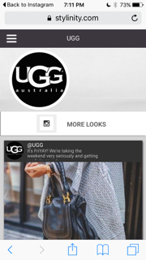
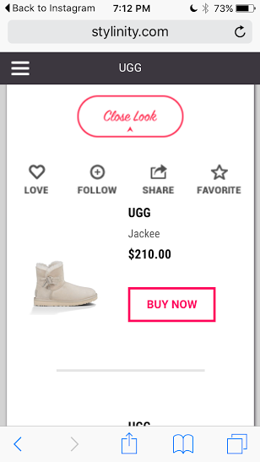
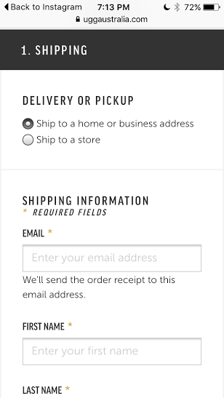
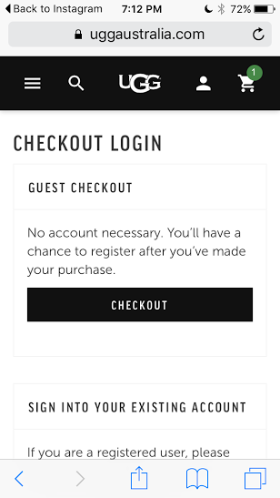
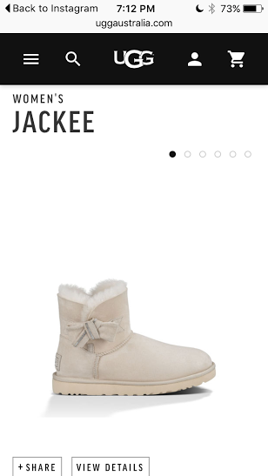
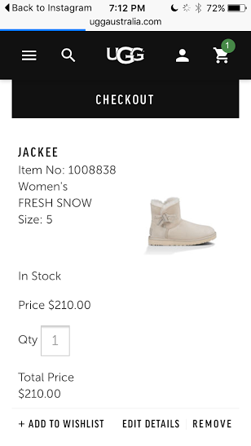
Notes:
Raise your hand if you have ever tried to buy something on your mobile device? Intro Discuss how this is a missed opportunity. Instagram made no additional revenue

Slide 3
Mobile devices represent 60% of browsing traffic for shopping sites, but they only make up 15% of purchases.

Slide 4
What does this have to do with Instagram?

Slide 5
Notes:
What is Stripe? Founded in 2011 by Patrick Collison Stripe is a technology company that allows both private individuals and businesses to accept payments over the Internet. What is Relay? Relay is an application processing interface (API) connecting through Apps on smartphones. How does this work for Instagram?

Slide 6
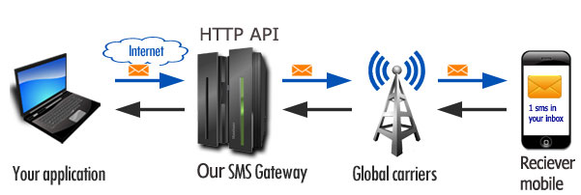
How does it work?
Notes:
Through Relay sellers are able to connect and enable a buy now button on any picture they post with any item they wish to sell. They can customise information through the App. The customers through Stripe’s payment feature makes the transaction and processes it through the Internet. Customers fill out information on Stripes website and are then from there able to purchase any item from a number of Apps that use Relay. Buy now buttons allow shoppers to buy an item right from the app without switching windows.

Slide 7
Notes:
Here is an example of how the buy now button will look on any users Instagram feed. Comment and Like buttons are still enabled with the addition of the buy now button. And the information about the item; price, sizes, etc will list in the comments section.

Slide 8
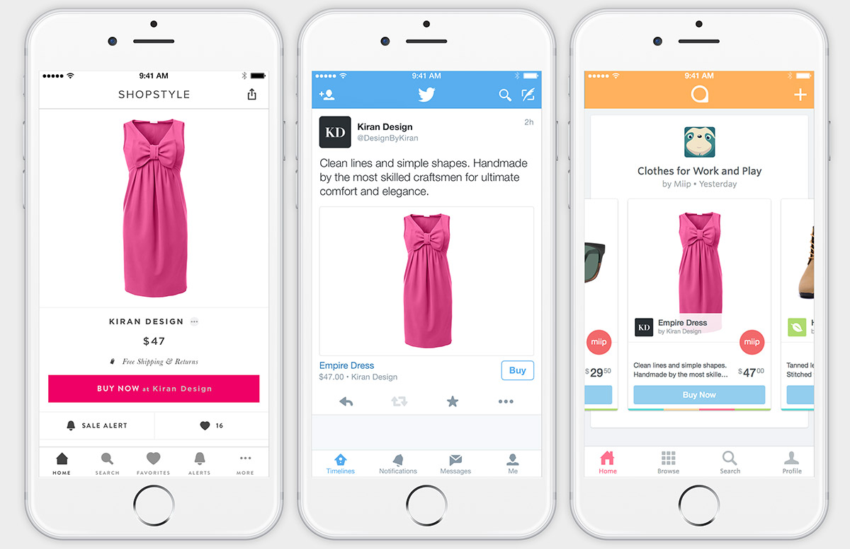
Notes:
How else is currently using Relay? Shopstyle, Twitter, are currently in testing phases, but are already seeing profits and creating models. (But there is no information about their numbers.) This is how it’s impacted these apps.. and now I will pass it to Winter to talk about how it will impact yours.

Slide 9
Instagram is ranked as HIGH RISK
Notes:
According to Hoover’s Company Overview, Instagram is currently ranked as a High Risk company. This score was determined through a pre-screening test that predicts Instagram to pay off debts in a severely delinquent manner. This has led Investors and analyst to question if Instagram can actually make a profit

Slide 10
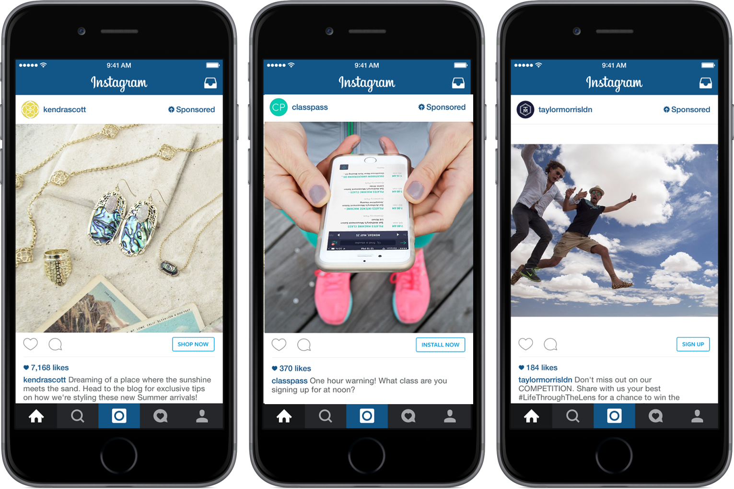
Instagram’s Current Revenue Model
Notes:
This year in June, Instagram, with the help of Facebook, created an API that adds buttons that allows certain advertisements to make them “clickable”. This allowed already paying advertisers to enable buttons on their ads that would allow customers to either learn more about a product or purchase a product (Instagram for Business, 2015)

Slide 11
Business Impact
Competitive advantage
Second revenue stream in addition to advertisements
Attract new users
Notes:
Mention Twitter’s model
Mention small businesses

Slide 12
So...What are the Competitive Advantages?
Notes:
Going off of Nick’s wonderful illustration of the potential financial opportunity present via this partnership, there is also a clear set of competitive advantages that will follow.
*future financial stability
*prevent Instagram from becoming too cluttered with advertisements, similar position to Myspace,
* greatly inhibit the operation capacity of Instagram to compete with its dynamic competitors.
*Stripe can also become a valuable partner for acquiring data on customer purchases, among other such areas, which would be of vital importance to a social media company like Instagram.
*This aspect become increasingly valuable when it is considered that, beyond advertising, companies like Pinterest and Snapchat do not have significant access to data regarding consumer behavior, customer purchases, and the success/failure of marketing campaigns.
*With Relay, Instagram, and the companies that market using its services, would be able to directly see how many users are viewing the sponsored images and video, and how many are making a purchase through our service.
*Furthermore, Instagram would be able to better use collaborative filtering in order to display more relevant sponsored content that a particular user would be likely to purchase.
*No other social media company would have this ability, and it would greatly separate Instagram from its immediate competitors
*When Facebook began to expand in terms of numbers of users, and created a dynamic environment for companies to foster and engage with its customers, many more interested companies followed.
*This expanded revenue opportunities, not just for the companies looking to engage with potential customers, but it also greatly benefitted Facebook with new users and marketers looking to its services. This can serve as a useful precedent for Instagram, as it looks to diversify its revenue sources, and strengthen its competitive advantage. The first step to doing so begins, however, with a partnership with Stripe and the implementation of Relay

Slide 13
Revenue Model Diversification

Slide 14
Wealth of Usable Data
Notes:
Collaborative Filtering

Slide 15
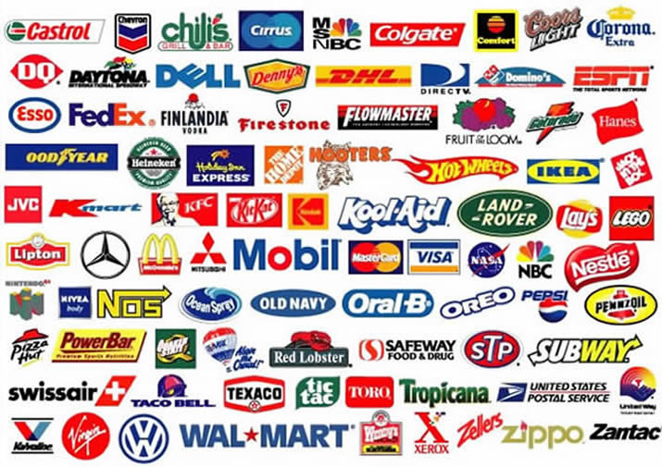
Growth of user base, Corporate partners

Slide 16
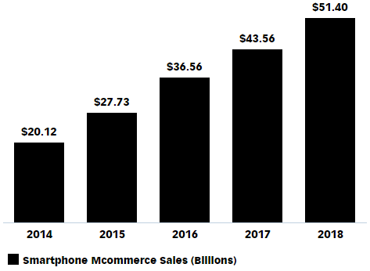
Market Growth
eMarketer, 2015

Slide 17
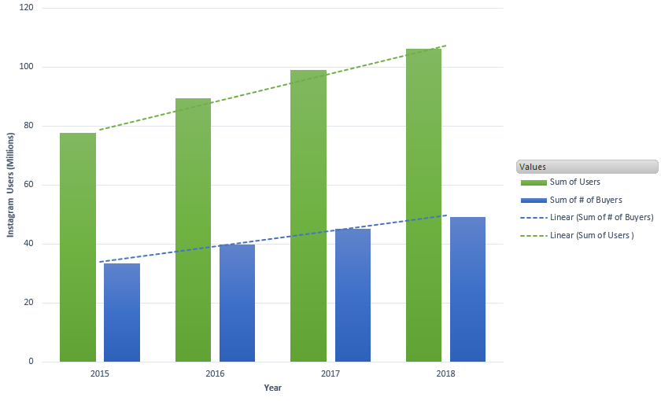
Who will use Stripe?
eMarketer, 2015

Slide 18
49,000,000
# of people that would be willing to buy products off instagram in 2018
eMarketer, 2015

Slide 19
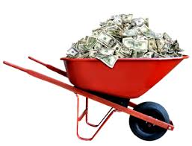
In 2018….
Flat rate of $3.00 USD
49 Million ‘Buyers’
$147,000,000
Per transaction

Slide 20
$401,000,000
What if you install Stripe today? By the end of 2018….

Slide 21
What’s your costs?
$0

Slide 23
Questions?
Notes:
Conclusion

