Slide 1
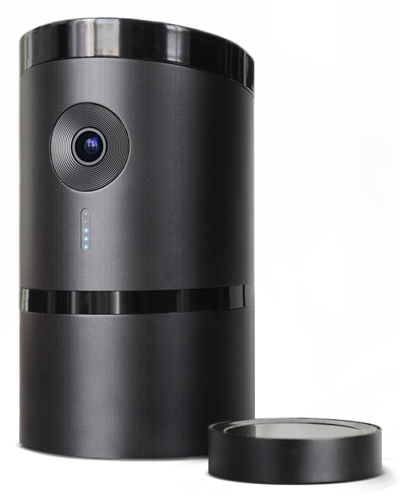
Anoud Alhowaish, Cypress Lee,
Isabel Terwindt and Nan Zhang
Notes:
Introduce ourselves

Slide 2
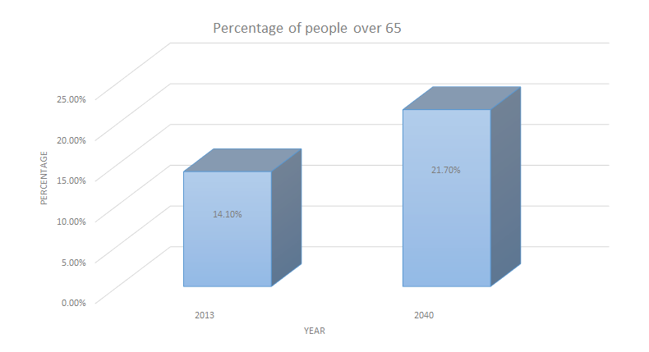
Story Until Now
21.70%
14.10%
Notes:
Cypress

Slide 3
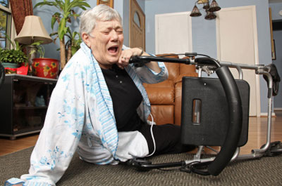
Problem
Notes:
Cypress:
HOME HEALTH CARE
grandma falls only 3x per week visit falls on day with no visit on the floor for days
WE HAVE SOLUTION

Slide 4
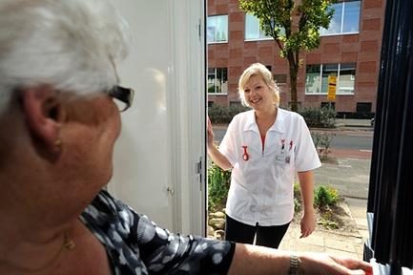
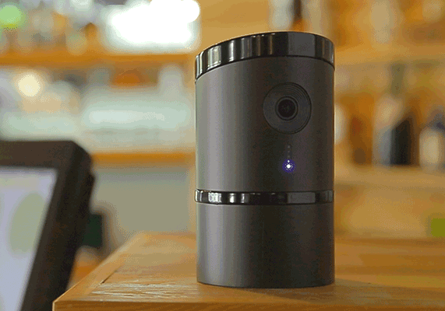
Our Solution: Angee
Notes:
Isabel

Slide 5
Features
360-degree Camera
Voice recognition
Notifications
Portability
Privacy mode
Notes:
Anoud

Slide 6
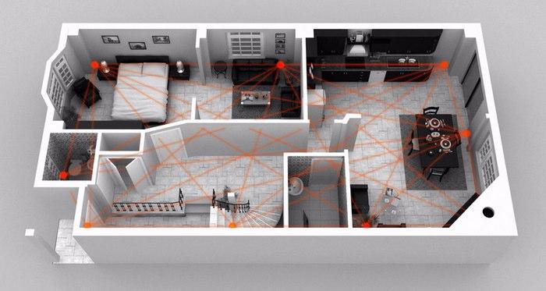
Only in Angee
Notes:
Anoud
Autonomous Arm/Disarm
Voice recognition
Motion sensor
Record, Stream and Share

Slide 7
Our Solution
Reduces cost and increases revenue
Home security and supervision
Improves customer experience: freedom
Notes:
Cypress

Slide 8
Acquiring Angee
Notes:
Isabel
Training of nurses to use angee → Implementing angee into homes → Increase our efficiency by utilizing angee → Increase profit by adding more homes to network

Slide 9
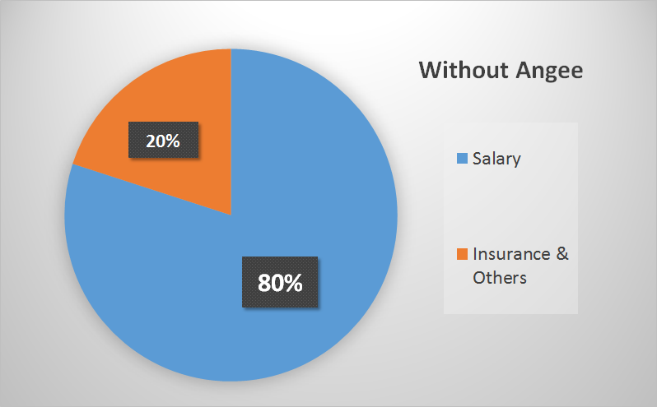
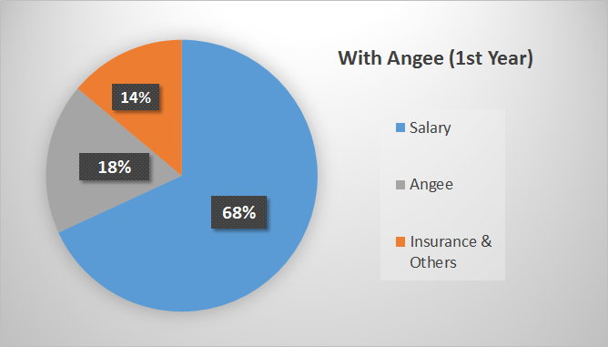
Home Nurse Company’s Annual Cost
50 families need 50 nurses
50 families need 10 nurses
$ 1,268,717
$ 358,131
Notes:
Nan

Slide 10
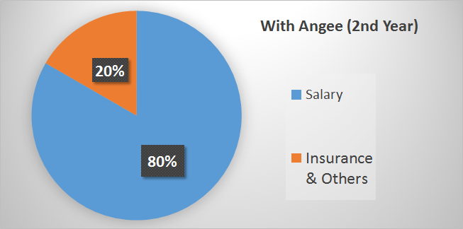
Home Nurse Company’s Annual Cost
$ 358,131
$293,781

Slide 11
Return on Investment
Revenue for 1st Year | $154,440
ROI (1st Year) | 195%
Revenue for 2nd Year | $219,790
ROI (2nd Year) | 211%
Notes:
Nan

Slide 12
Possible Concerns
Privacy with video surveillance
Possibility of being hacked
Notes:
Isabel

Slide 13
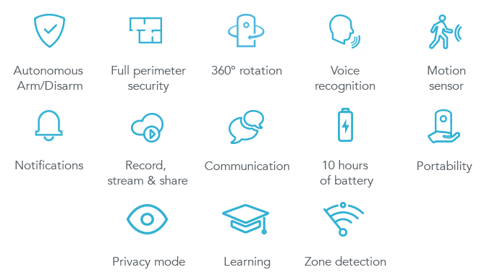
Notes:
THE END

Slide 14
Appendix I
Home Care Association of America
The HCAOA is an association for private home care, both medical and nonmedical, providing information regarding the practice of home care. The Association has a strong membership of providers.

Slide 15
Appendix II
Price of Home Health Care
Type | Average | Annual
Nursing home: semi private room | $214/day | $78,110
Nursing home: private room | $239/day | $87,235
Assisted living | $3,477/month | $41,724
Home care: home health aide | $21/hour | $21,840
Notes:
Appendix I

Slide 16
Fixed Costs
Appendix III
The price of three Angees is $1,287.
Nursing Assistants’ salary is $11.73 per hour.
Other expenses: $48,797
Notes:
Nan

Slide 17
Appendix IV
Additional Features
Power outage: If the power were to go out, Angee would continue to work. Run off battery power.
Battery life: 10 hours

Slide 18
References
Administration on Aging (2015). Aging statistics. Web. 16 Nov. 2015.
Bureau of Labor Statistics (2012). United States Department of Labor.. Web. 18 Nov. 2015. Retrieved from
http://www.bls.gov/ooh/healthcare/nursing-assistants.htm
Gebhart, A. (2015). Angee promises to look and listen attentively to keep your home safe. Retrieved
from http://www.cnet.com/products/angee/
Home Care. Home Care Association of America. Web. 27 Nov. 2015. Retrieved from
http://www.hcaoa.org
Kickstarter (2015) Angee, The First Truly Autonomous Home Security System. Retrieved from
https://www.kickstarter.com/projects/tomtu/angee-the-first-truly-autonomous-home-security-sys/description
Metropolitan Life Insurance Company (2012). MetLife Market Survey of Nursing Home,Assisted
Living, Adult Day Services, and Home care Costs. Retrieved from
https://www.metlife.com/mmi/research/2012-market-survey-long-term-care-costs.html#keyfindings
Pasolini, A (2015) Angee automated home security system doubles as a personal assistant.
Retrieved from http://www.gizmag.com/angee-home-security-system/39370/
PayScale (2015). Nurse Home Care Salary. Web. 16 Nov. 2015.
Turek, Tomas (2015). Angee. Protect Your Home. Connect to Your World. Web. 23 Nov. 2015. Retrieved from
https://www.indiegogo.com/projects/angee-protect-your-home-connect-to-your-world#/

